Slide 1
+
NEW, TRENDING & NEXT
WITH DILLARD’S & ACCELERATED ANALYTICS

Slide 2
We have a lot to catch up on today!
WELCOME!
State of the Dillard’s universe
Who was the “Power User” of 2018?
Our Dillard’s solution product road map – ENHANCEMENTS!
Best practices
Tips and Tricks
Reports to engage your Buyer
Polling YOU to gain your insights
PRIZE giveaway!
Opportunity for Q&A
COPYRIGHT 2019

Slide 3
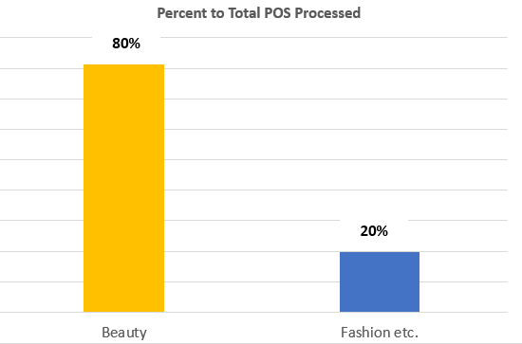
We processed over $1B in Dillard’s-only POS
2018 INDEX FOR DILLARD’S
COPYRIGHT 2019

Slide 4
2018 / 2017 COMPS
Dillard’s Total Sales Up 1%
Dillard’s Comp Doors Up 2%
All Accelerated Vendors Up 0.4%
AA Beauty Vendors Up 2%
AA Fashion Etc. Vendors Down 3%
Q418 Dillard’s Reported Strongest Growth:
Home/Furniture
Cosmetics
Men’s Clothing
Accessories
COPYRIGHT 2019

Slide 5
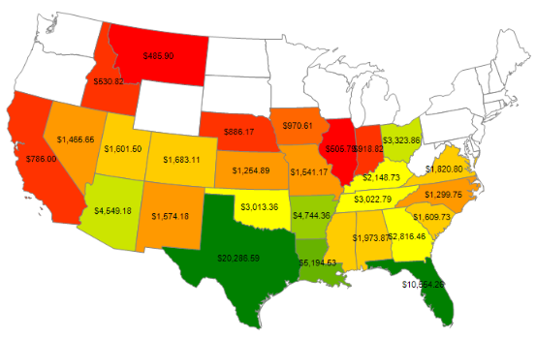
2018 / 2017 COMPS BY DIVISION
DIVISION | DIV 02 | DIV 04 | DIV 07 | DIV 09 | DIV 05 | DIV 06
Region | East | Central | Central | West | Clearance | .com
All AA | .08% | 2.1% | -1.6% | 1.2% | 43.8% | 6.4%
Cosmetics | 1.9% | 3.4% | -.6% | 2.2% | 421% | 8.6%
Fashion etc. | -2.6% | -2.9% | -6.1% | -4.2% | -40% | 2.9%
Q418 Dillard’s Reported Strongest Growth:
East West Central
COPYRIGHT 2019

Slide 6
POWER USER 2018!
Honorable Mentions
Lisa Bailey Coty 457
Sharon Kramer LVMH 441
Ana Ferris Osmotics 415
Kelly Williams Estee Lauder 404
18,184 TOTAL!!!
Bill Goodwin
Elizabeth Arden!
812 Log Ins!

Slide 7
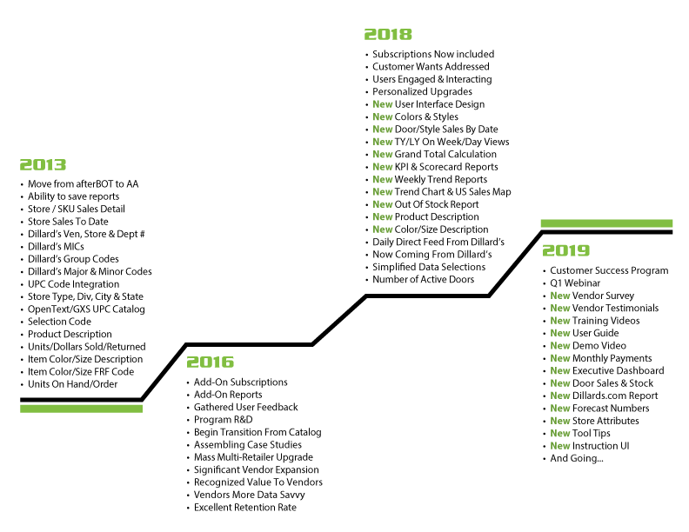
DILLARD’S SOLUTION PRODUCT ROADMAP
COPYRIGHT 2019

Slide 8
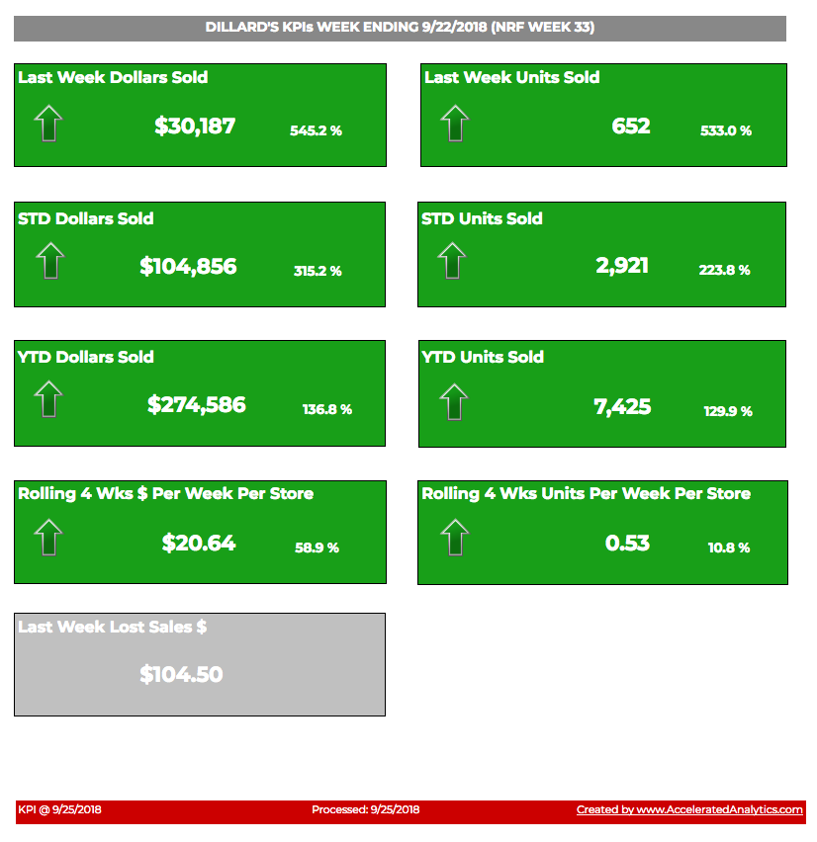
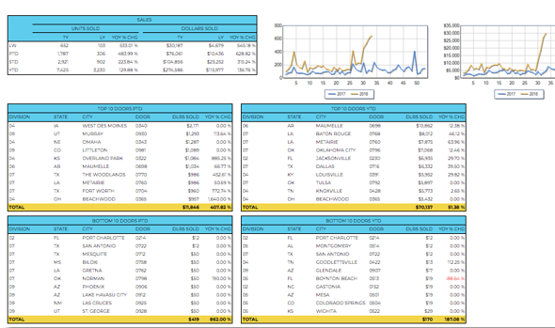
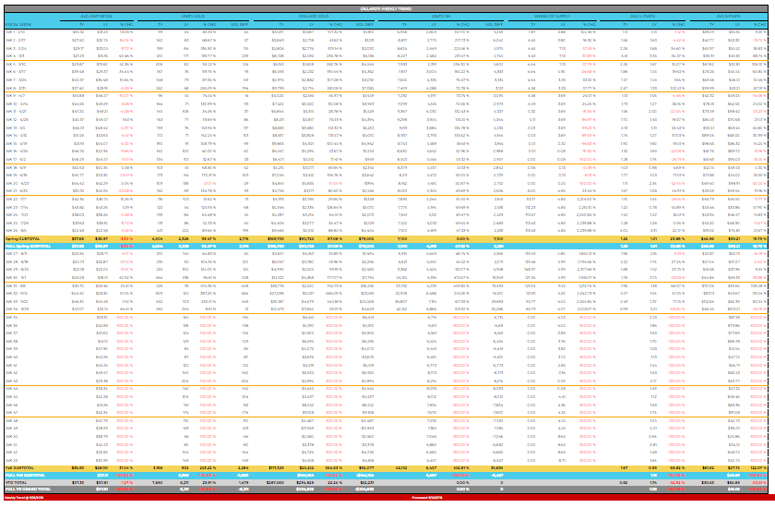
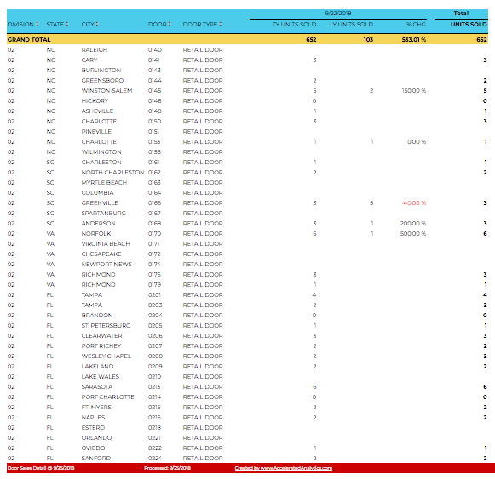
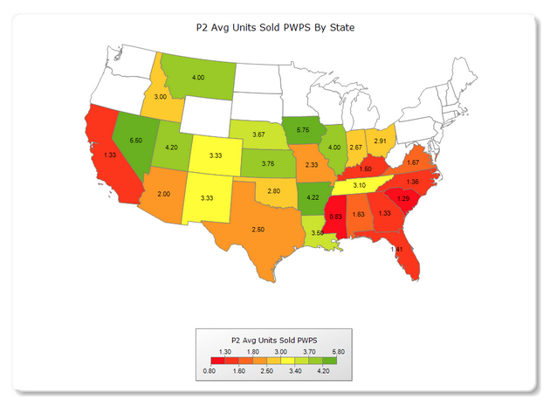
POLL: WHICH REPORT DO YOU USE AND RELY ON THE MOST?
KPI: .41 % OF USAGE
SCORECARD: 1.4 % OF USAGE
WEEKLY TREND: .27 % OF USAGE
US MAP: .41 % OF USAGE
DOOR SALES BY DATE: 55.4 % OF USAGE
COPYRIGHT 2019

Slide 9
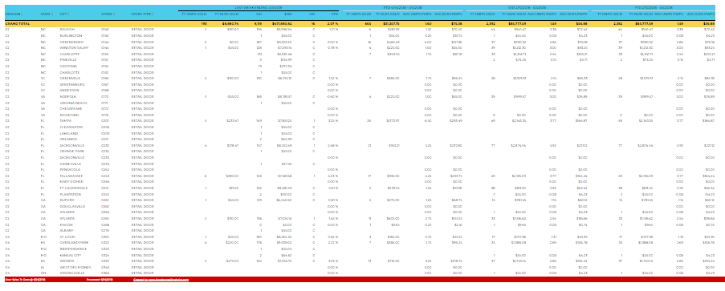
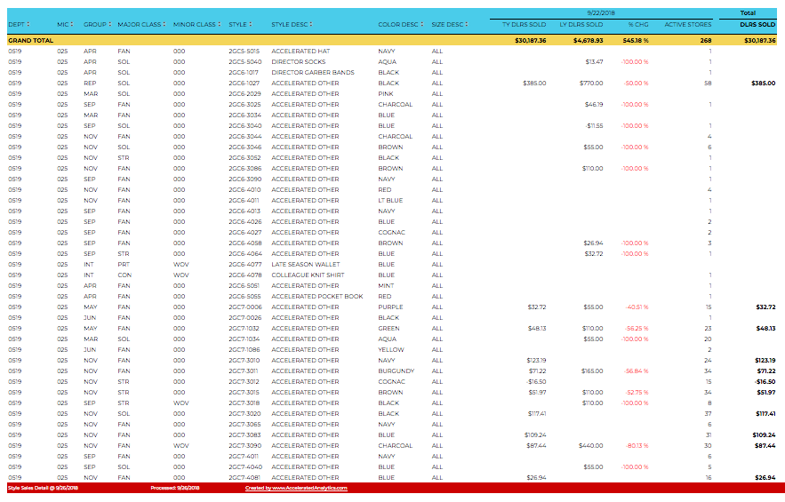
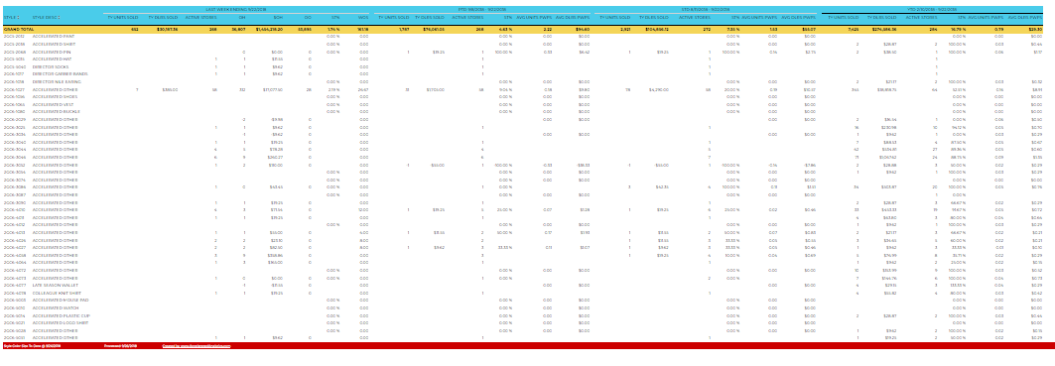
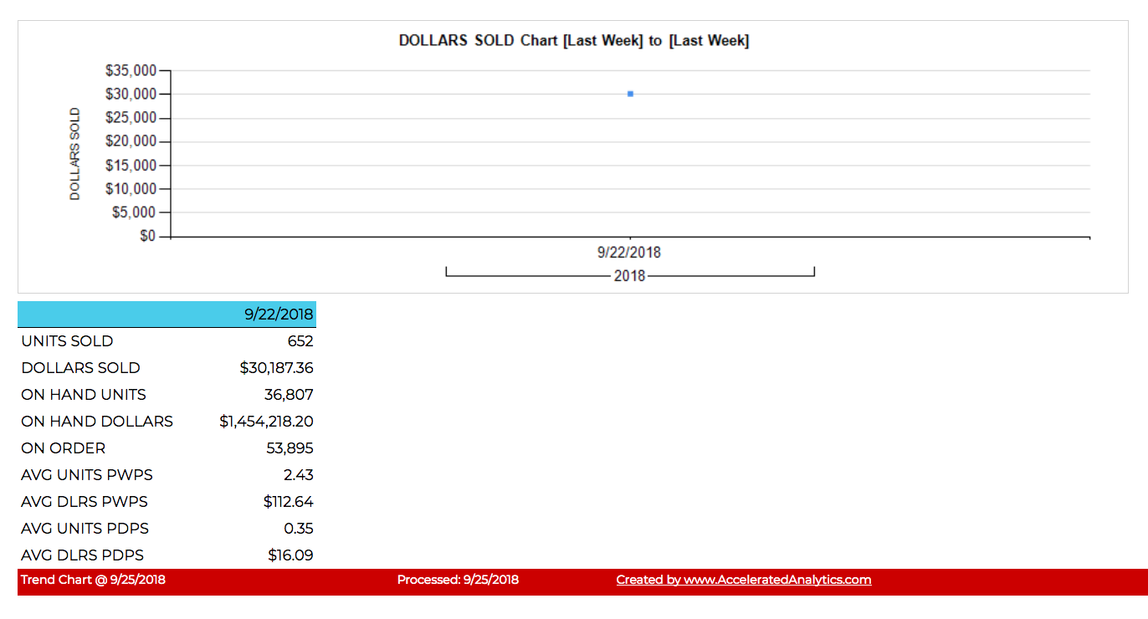
POLL: WHICH REPORT DO YOU USE AND RELY ON THE MOST?
DOOR SALES (W/M/S/Y): 18.8 % OF USAGE
STYLE SALES BY DATE: 9.6 % OF USAGE
STYLE SALES (W/M/S/Y): 11.8 % OF USAGE
OUT OF STOCK: 1.2 % OF USAGE
TREND CHART: .61 % OF USAGE
COPYRIGHT 2019

Slide 10
POLL: WHICH REPORT DO YOU USE AND RELY ON THE MOST?
KPI: .41 % OF USAGE
SCORECARD: 1.4 % OF USAGE
WEEKLY TREND: .27 % OF USAGE

Slide 11
New Features for Door Sales by Date & Style Sales by Date Reports:
POLL: ARE YOU USING THE REPORTS TO LOOK AT DAILY DATA?
Daily and Weekly available: choose Time Period > End Date > Start Date
This Year / Last Year all on one report, even by DAY!
Grand Total rows are at the top of the report
Choose your measures in the report
COPYRIGHT 2019

Slide 12
POLL: ARE YOU USING THE REPORTS TO LOOK AT DAILY DATA?

Slide 13
NEW REPORTS TO ENGAGE WITH YOUR BUYER
COPYRIGHT 2019

Slide 14
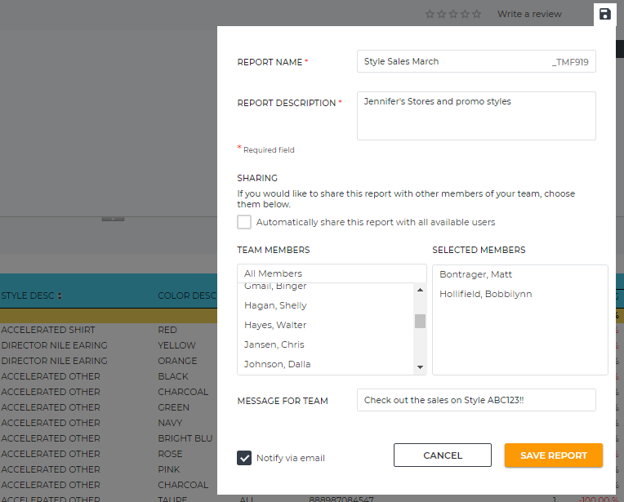
TIP: SAVING & SHARING REPORTS USING SUBSCRIPTIONS
COPYRIGHT 2019

Slide 15
POLL: WHICH NEW REPORT HAVE YOU FOUND THE MOST VALUABLE?
COPYRIGHT 2019

Slide 16
POLL: WHICH NEW REPORT HAVE YOU FOUND THE MOST VALUABLE?

Slide 17
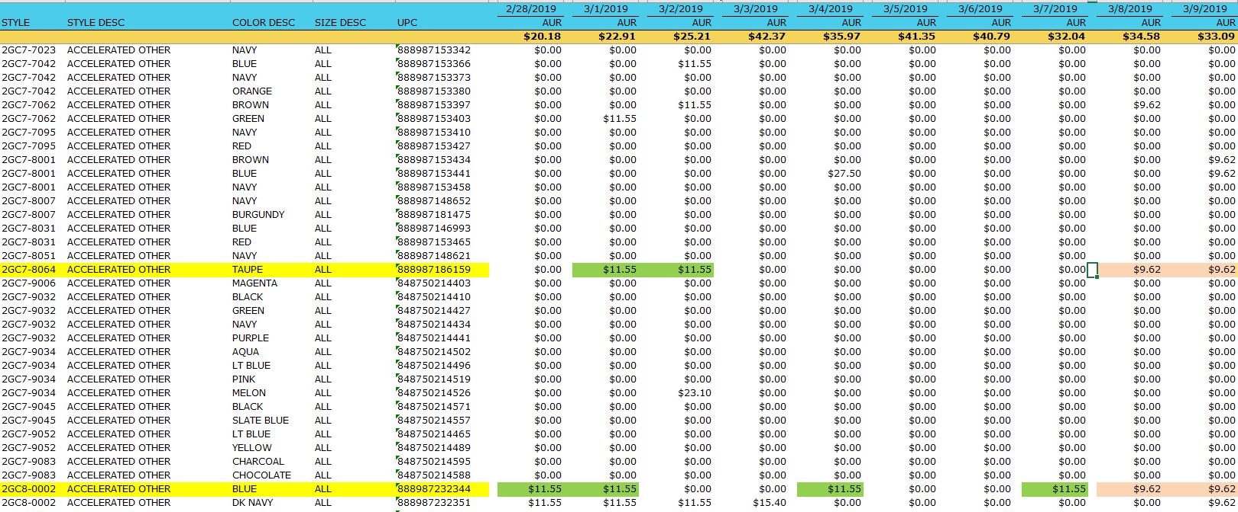
TIP: MARKDOWNS ARE NOT SHARED BY DILLARD’S (IS THERE A WORK-AROUND?)
COPYRIGHT 2019

Slide 18
POLL: IF YOU COULD HAVE SIMILAR REPORTING FOR ANOTHER RETAILER…
WHO WOULD BE AT THE TOP OF YOUR LIST?
COPYRIGHT 2019

Slide 19
POLL: IF YOU COULD HAVE SIMILAR REPORTING FOR ANOTHER RETAILER…
WHO WOULD BE AT THE TOP OF YOUR LIST?
KPI: .41 % OF USAGE
SCORECARD: 1.4 % OF USAGE
WEEKLY TREND: .27 % OF USAGE

Slide 20
SURVEY: IF WE COULD PROVIDE YOU WITH SOMETHING NEW/ELSE…
WHAT WOULD YOU LIKE TO SEE?
COPYRIGHT 2019

Slide 21
Recording will now end… please type a chat or question to me now
if you would like a follow up call with individual questions!
Thank you for joining us today!
We look forward to a GREAT 2019!

Slide 22
The Tools You Need to Win at Retail®
www.AcceleratedAnalytics.com | 941-238-9091
Jennifer@AcceleratedAnalytics.com

